Slide 1
Automated Evaluation of Party Manifestos
By: Michelle Corea, Molly Jacobs, Tim McDade, Mateo Villamizar-Chaparro, Kyle Chan

Slide 2
Roadmap
The Manifesto Project
The dimensionality of parties
Content Analysis of English-speaking countries’ party manifestos
LDA
STM
Text Networks
Concluding Remarks

Slide 3
The Manifesto Project
Started 2009.
Collects information on party manifestos from multiple countries.
Coding is done by 50 experts from all around the world.

Slide 4
The dimensionality of parties

Slide 5
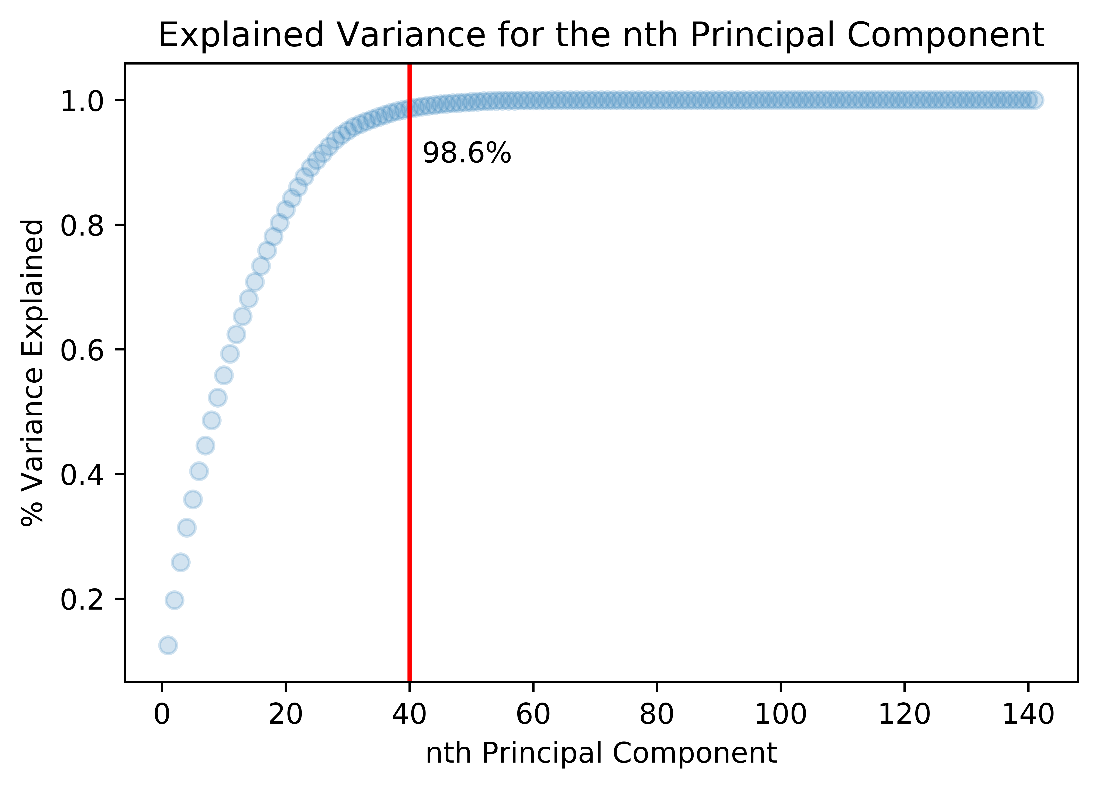
Unsupervised learning
With 40 components we were able to explain most of the variation in our dataset.

Slide 6
Feature Composition

Slide 7
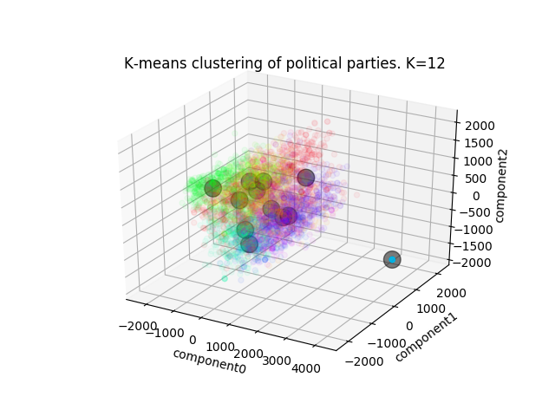
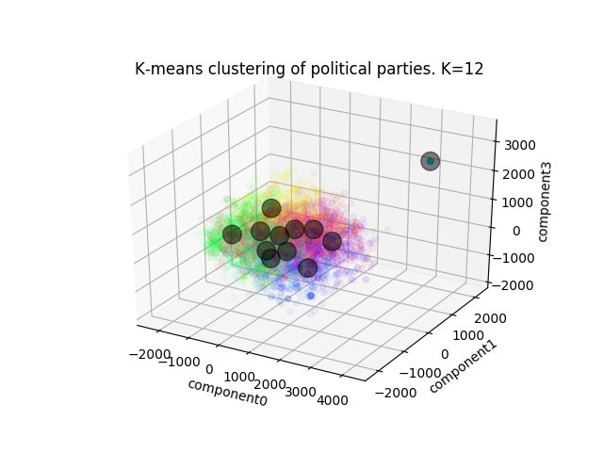
K-mean clustering i

Slide 8
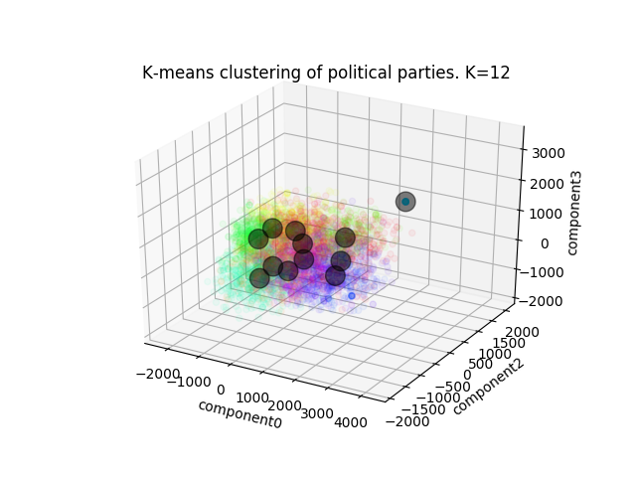
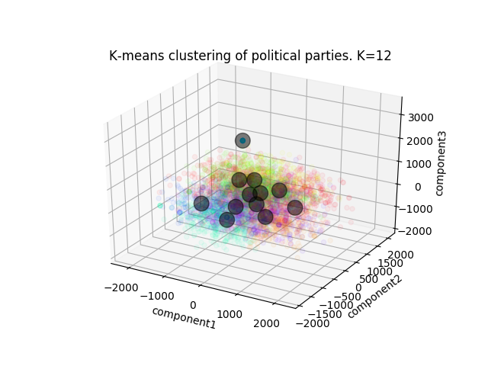
K-mean clustering iI

Slide 9
Neural Networks - Unsupervised
Neural Networks
K - fold
Test Set
The neural net, with a train/test split, was 41.7% accurate, and when we did k-fold cross validation, the neural net was 25.6% accurate

Slide 10
Comparing manual and ML categories
Nearest Neighbor: ~24% success
C-Support Vector Classification (SVC): ~23%
N-1 dimensional plane between groups (create boundaries)

Slide 11
Text Analysis

Slide 12
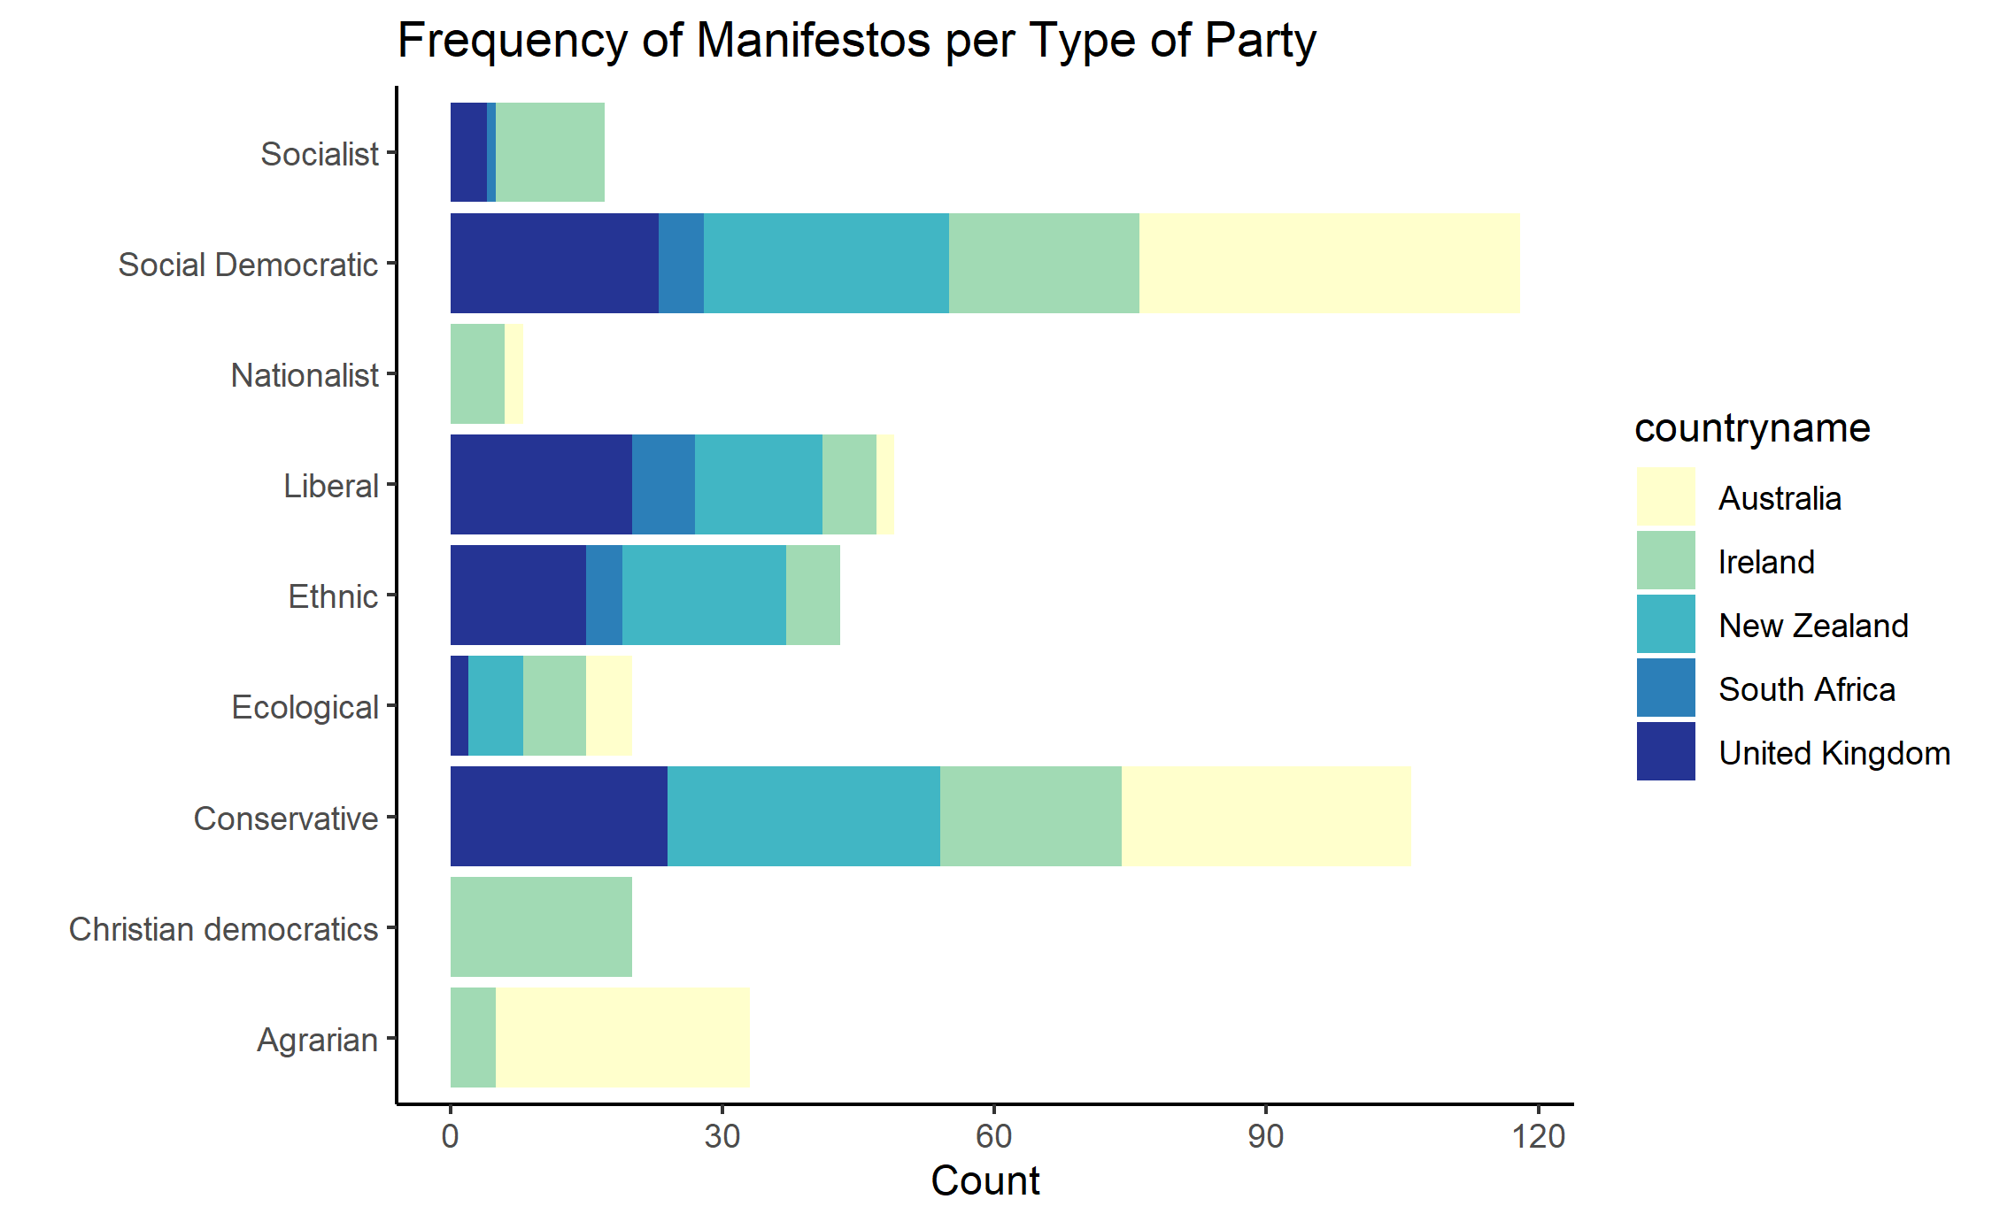
LDA – For English Speaking Countries
Played with the number of categories and 4 seemed the most meaningful

Slide 13
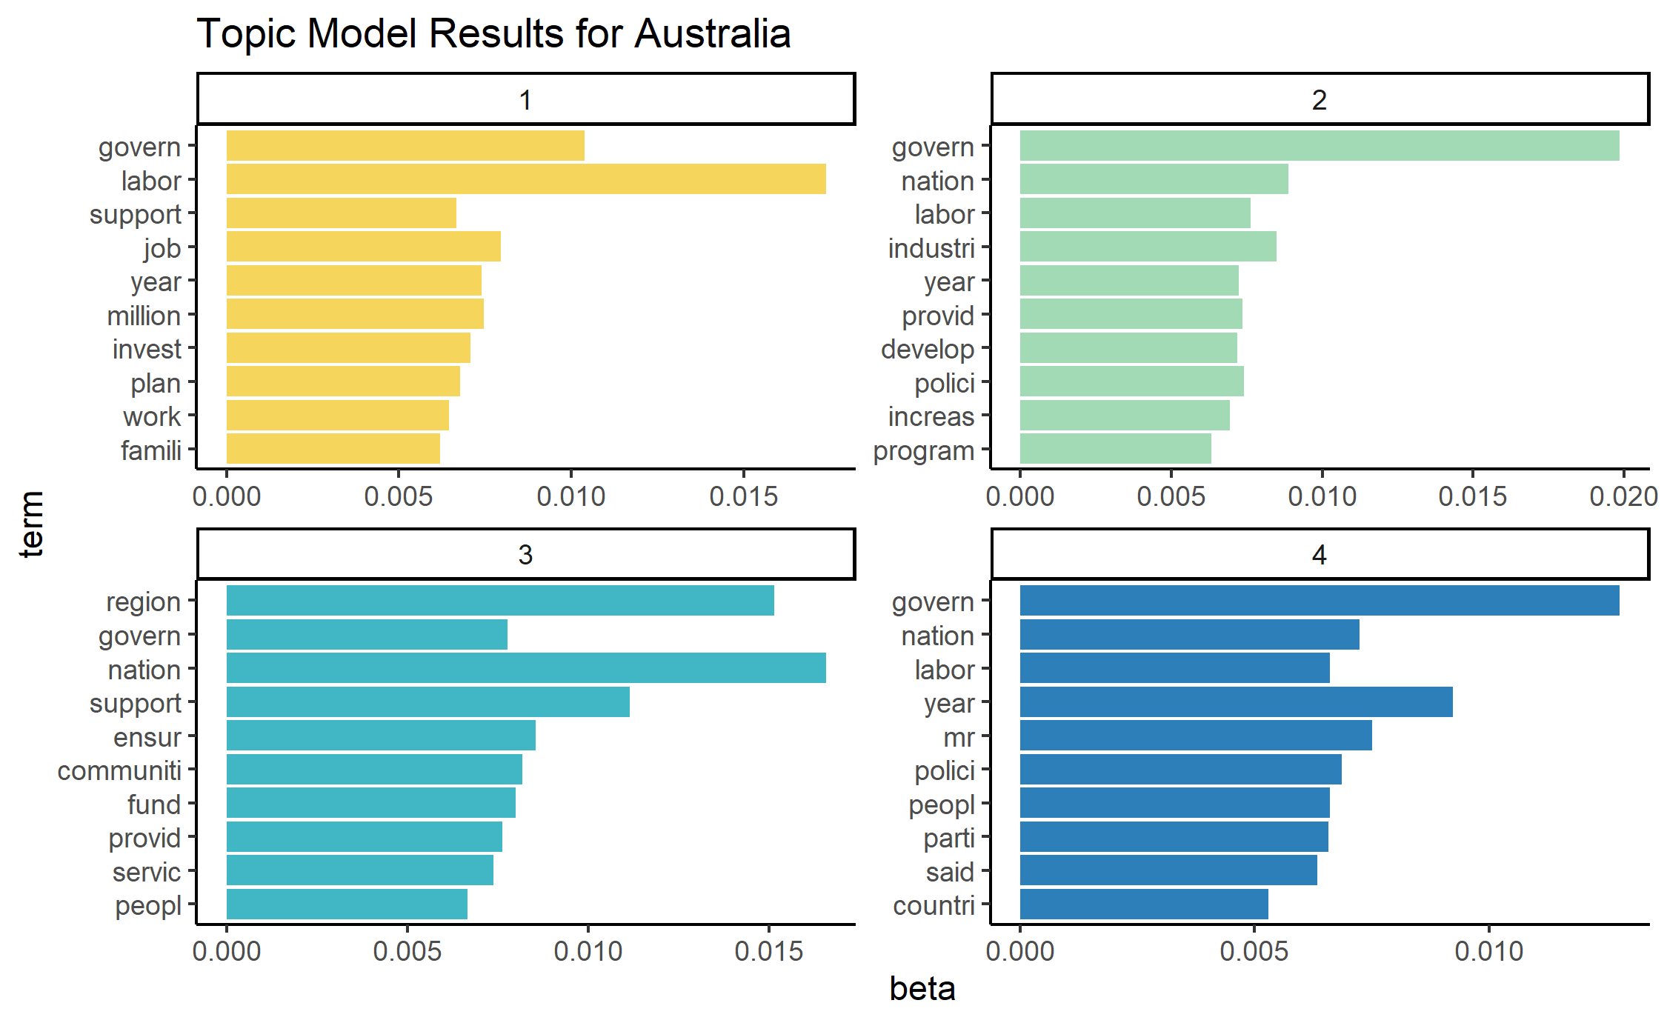
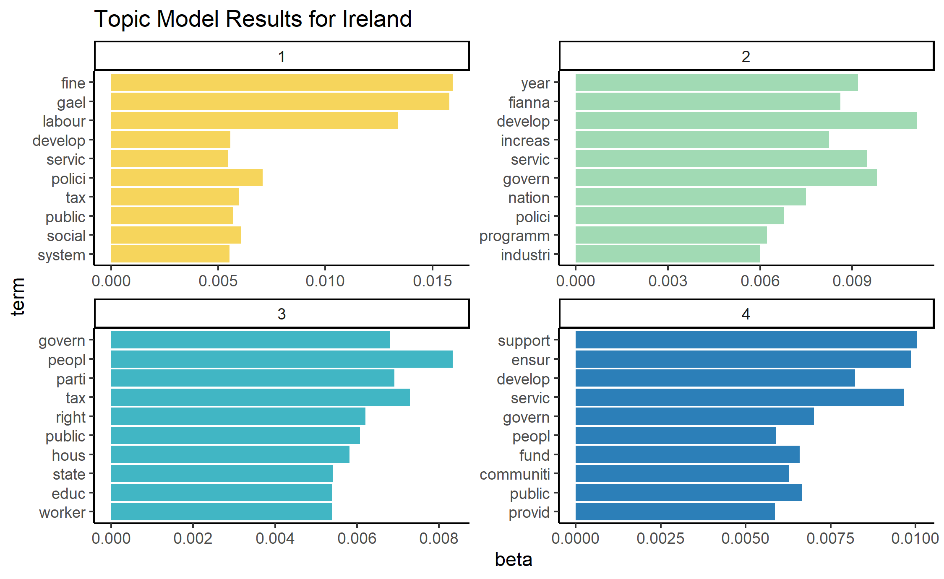
LDA - Country results

Slide 14
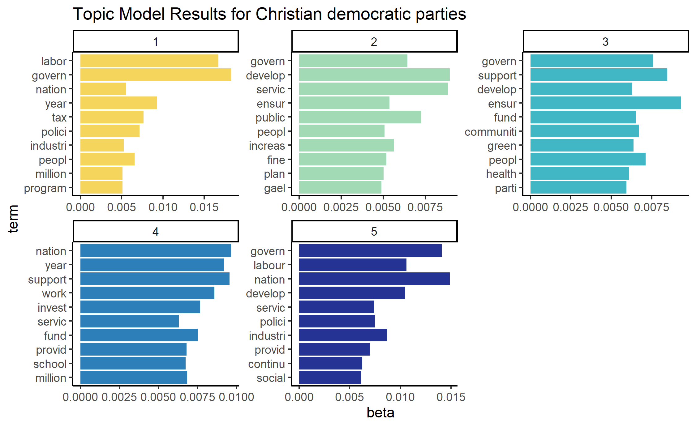
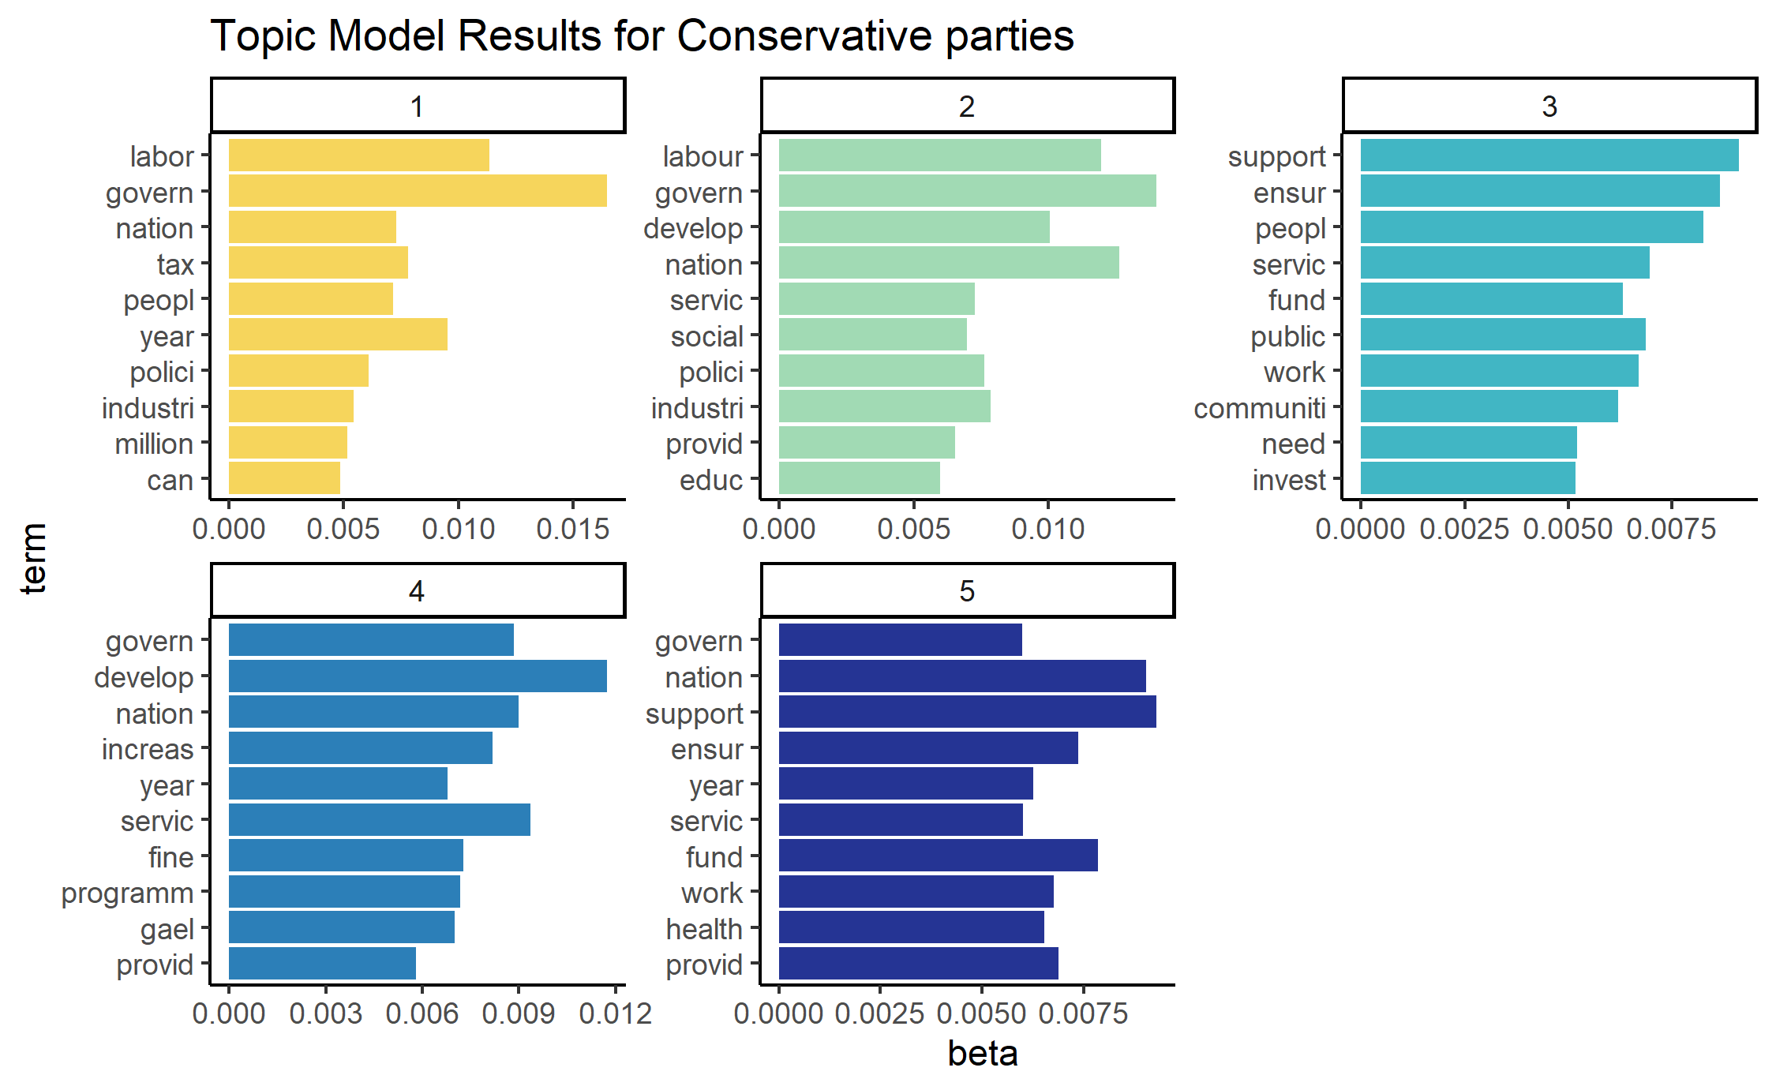
Lda - Type of Parties i

Slide 15
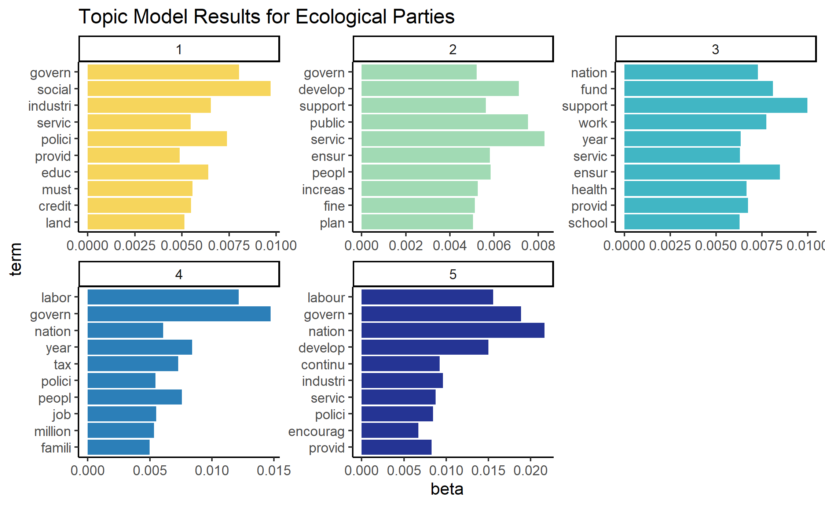
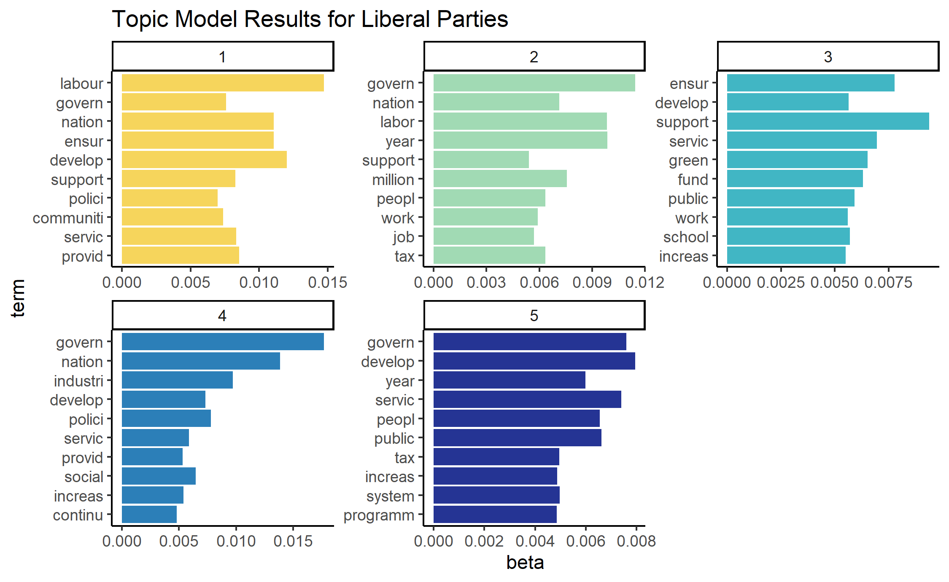
Type of parties ii

Slide 16
Structural Topic Models

Slide 17
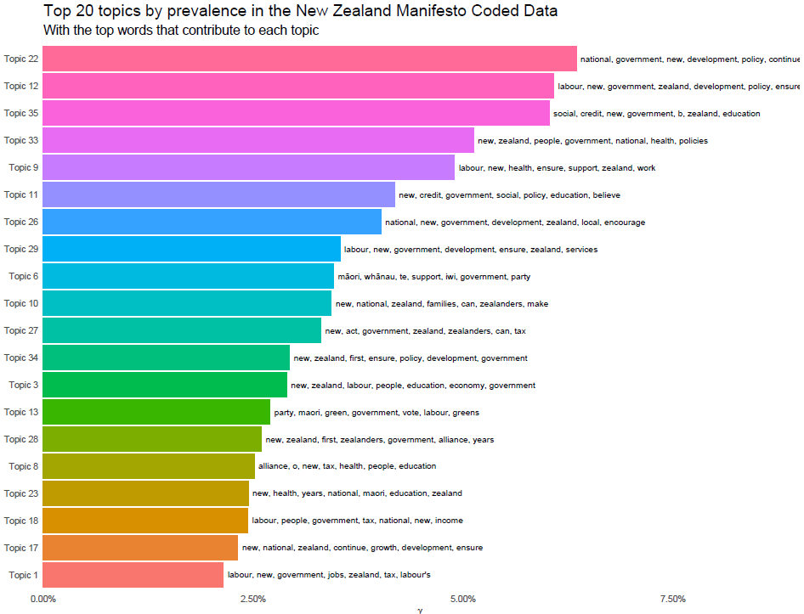
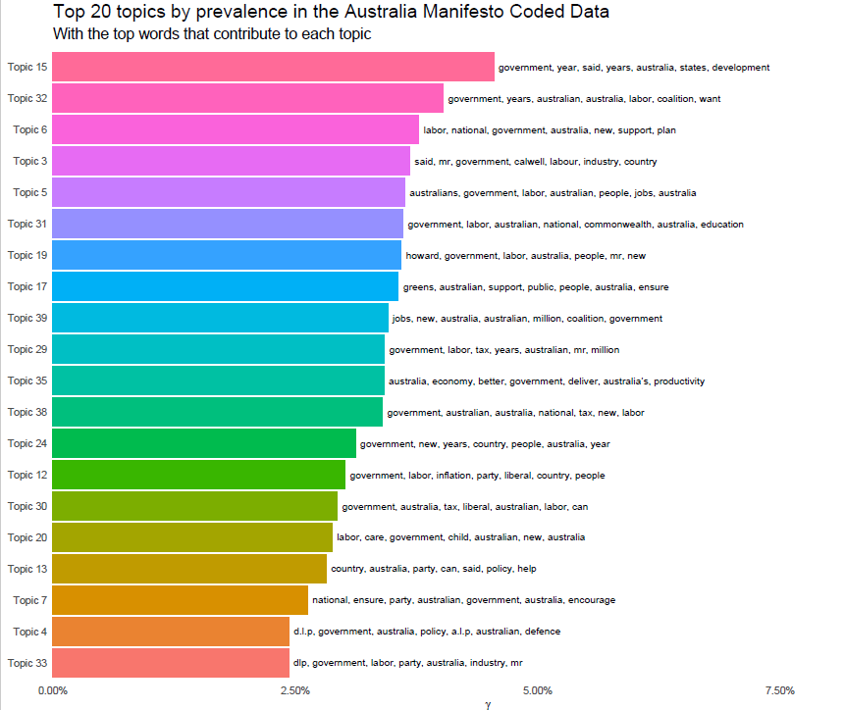
STM I - By country

Slide 18
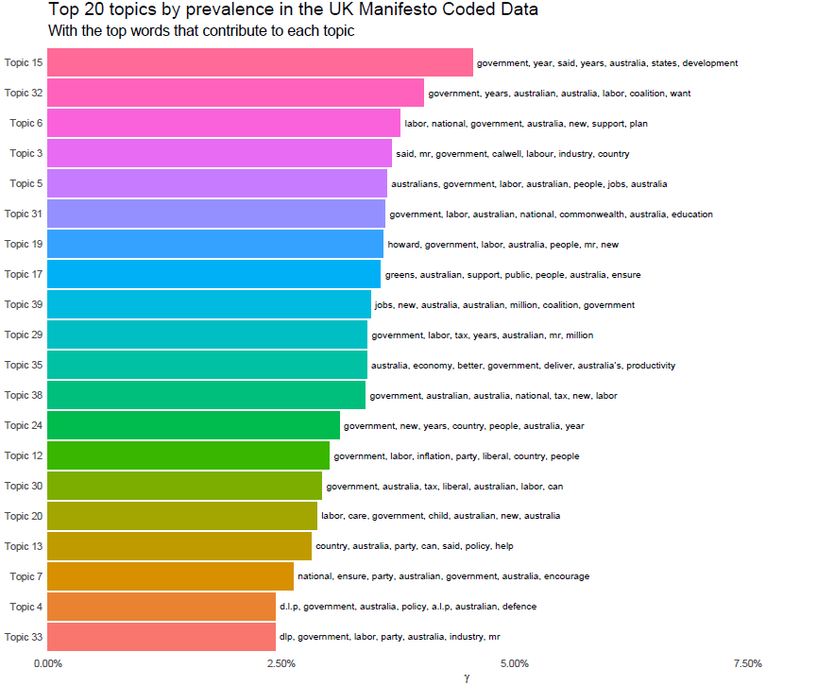
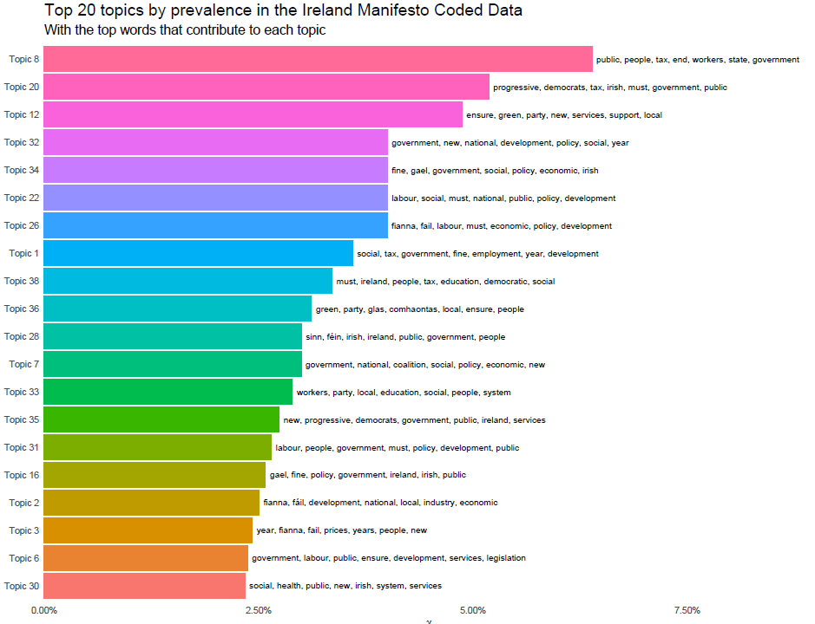
STM II - by country

Slide 19
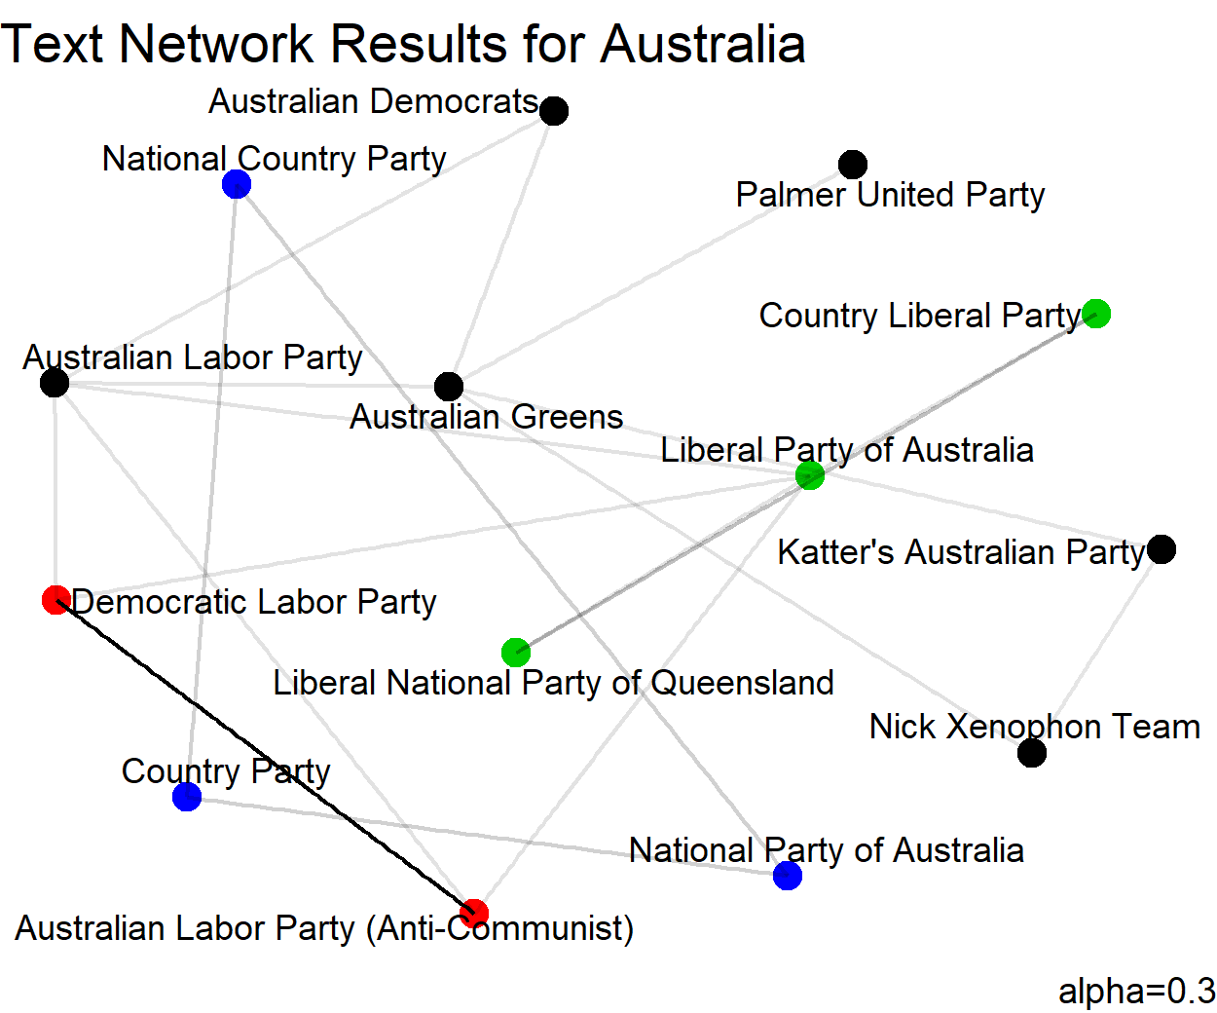
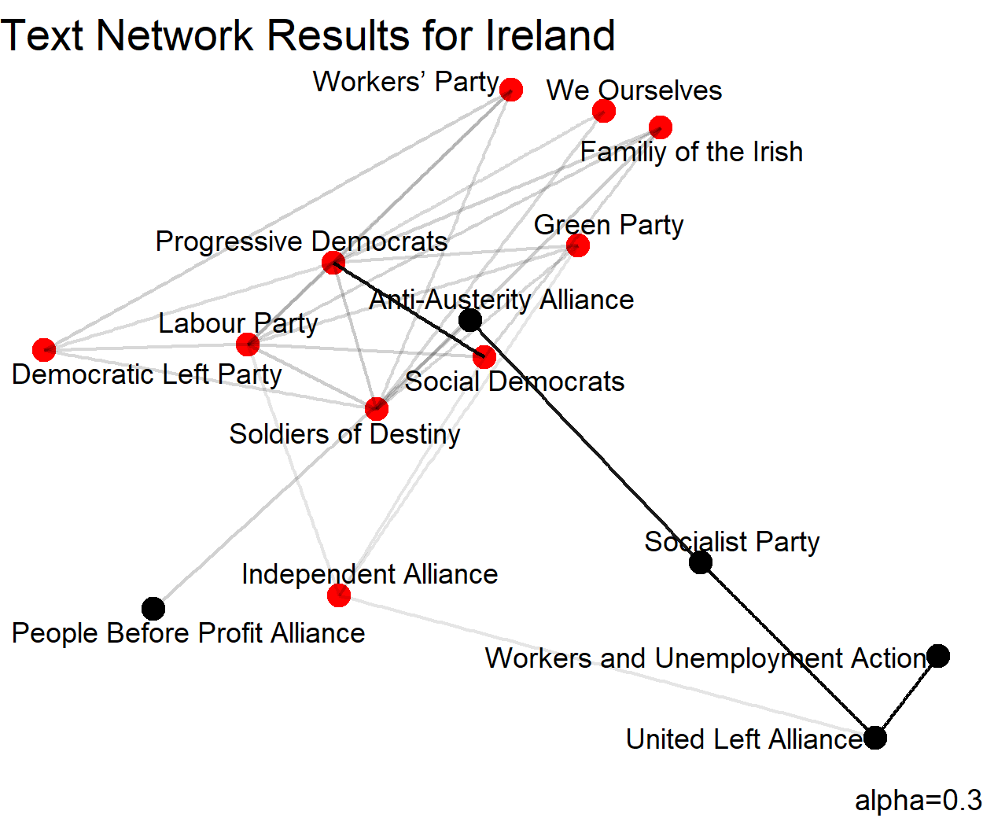
Text Networks i

Slide 20
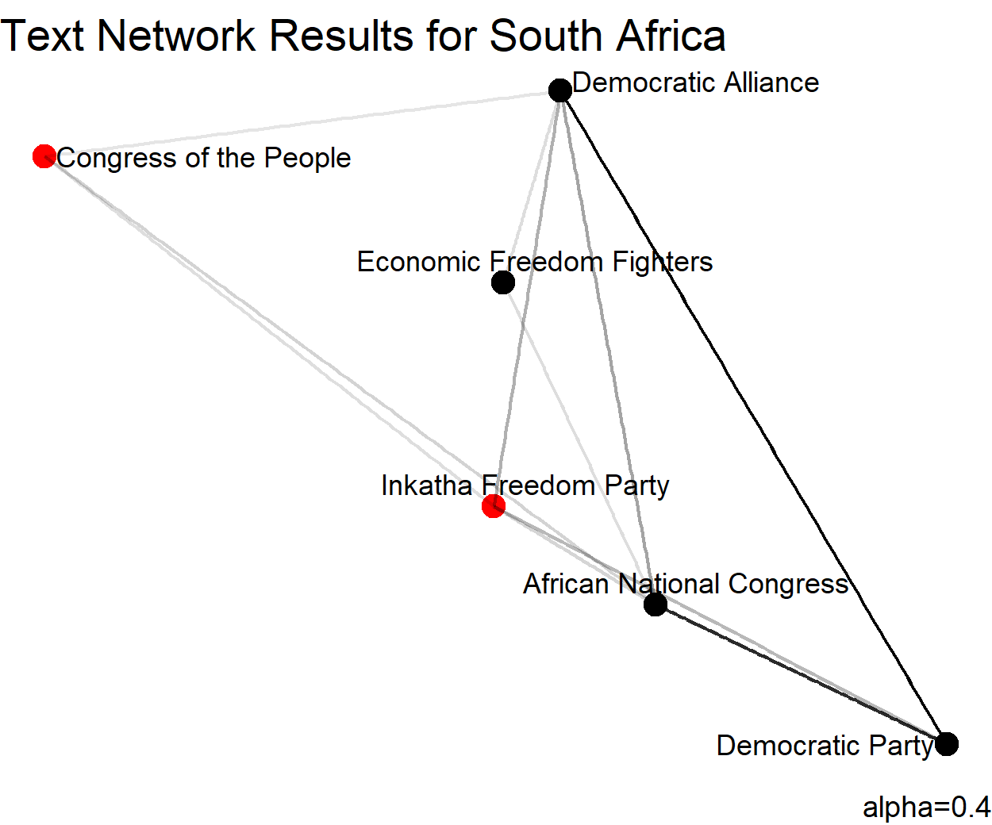
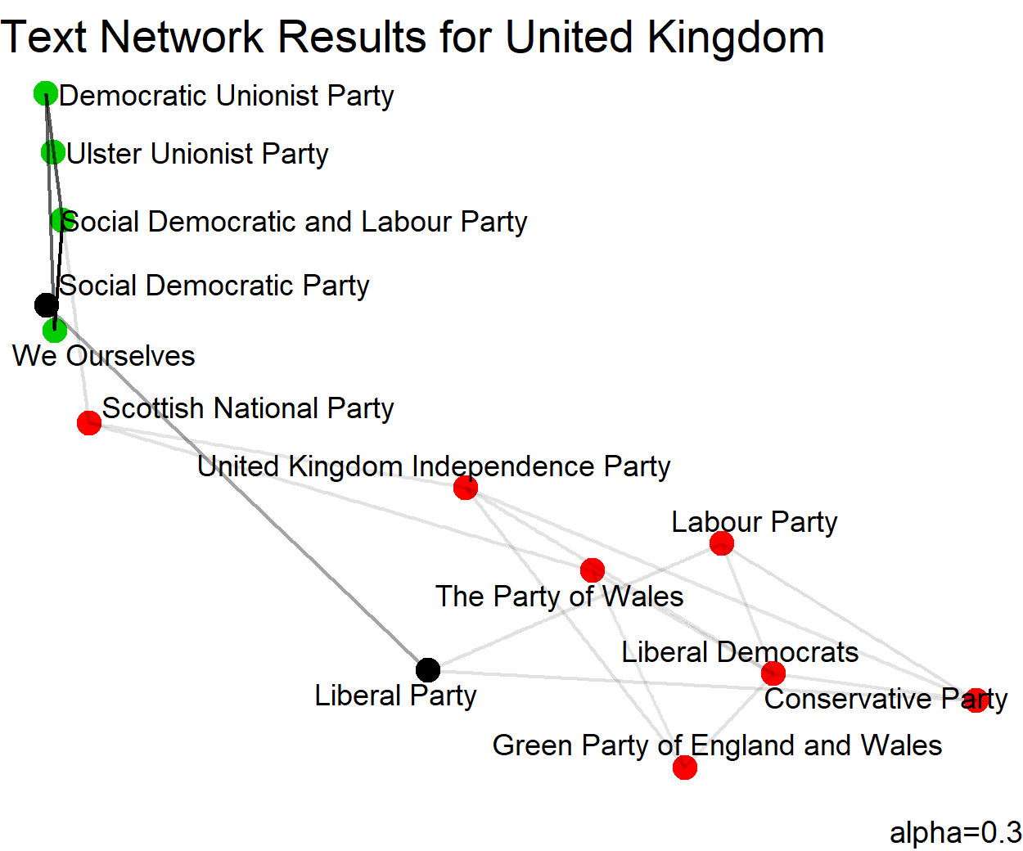
Text Networks iI

Slide 21
Concluding Remarks and future directions
Party manifestos seems harder to locate in a simple 2-dimensional space.
40 components
Still very similar to one another
Parties in English speaking countries (independent of their “ideological classification”) don’t seem so dissimilar in terms of the text used in their manifestos
Are manifestos a good informational tool for parties? Do they create differences in perceptions among voters?

Slide 22
THANK YOU
All our code can be found in https://github.com/trmcdade/Manifesto

